Slide 2
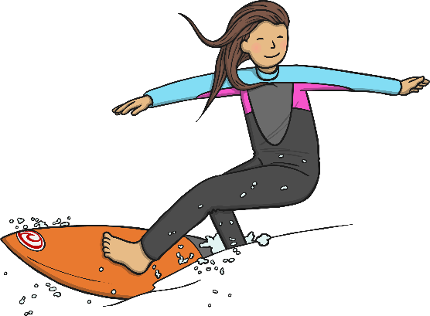
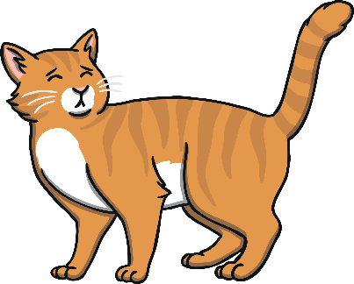

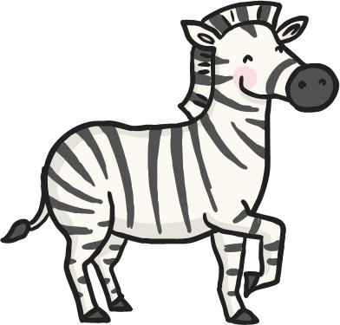


Click the pictures that contain the ‘ur’ sound to move them into the middle.
ur

Slide 3
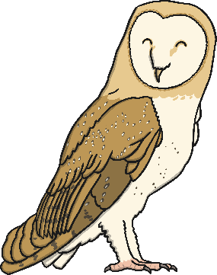
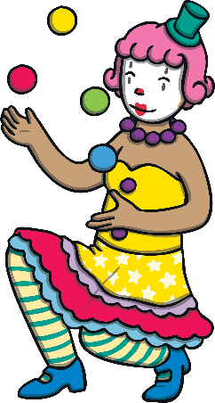

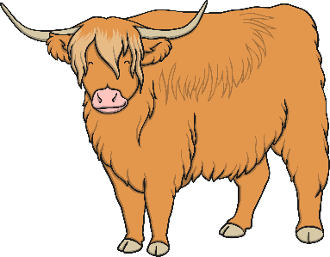


Click the pictures that contain the ‘ow’ sound to move them into the middle.
ow

Slide 4

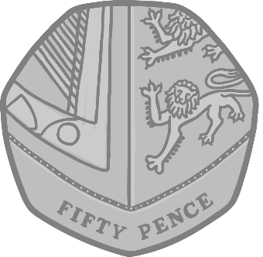

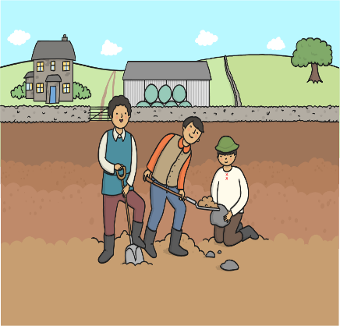


Click the pictures that contain the ‘oi’ sound to move them into the middle.
oi

Slide 5

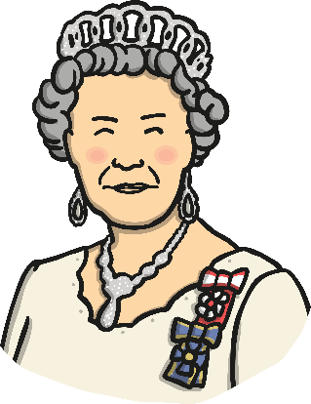


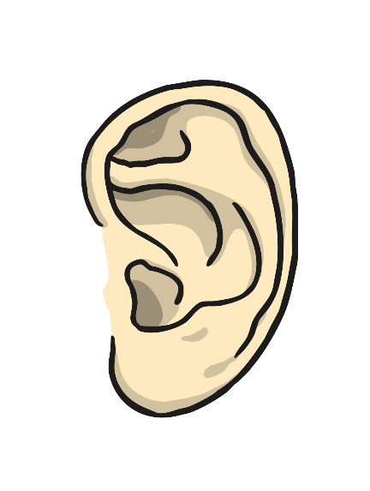

Click the pictures that contain the ‘ear’ sound to move them into the middle.
ear

Slide 6

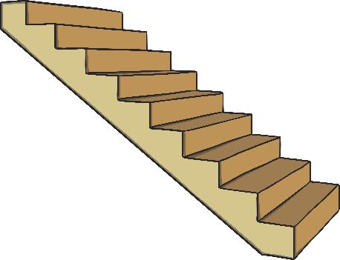
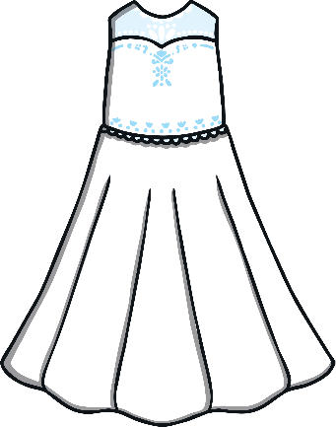
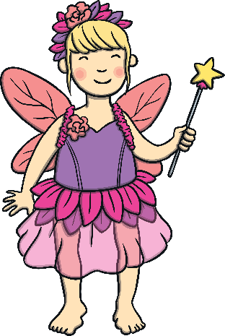

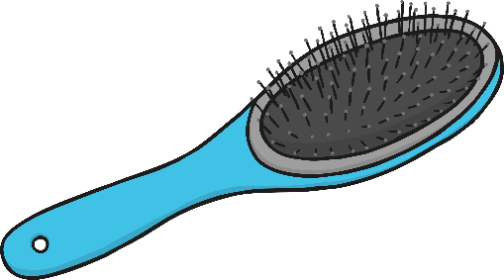
Click the pictures that contain the ‘air’ sound to move them into the middle.
air

Slide 7
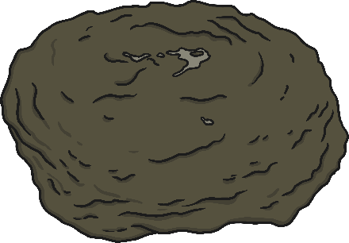





Click the pictures that contain the ‘ure’ sound to move them into the middle.
ure

Slide 8




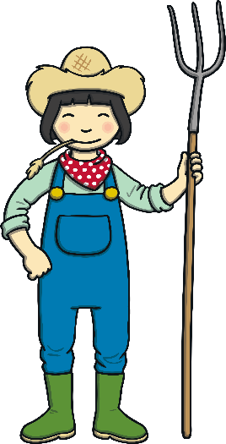

Click the pictures that contain the ‘er’ sound to move them into the middle.
er

Slide 9







ur
oi
air
er
ow
ear
ure

