Slide 1
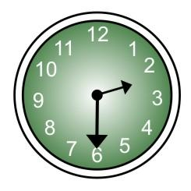
It’s

Slide 2
How many paws can you see?
How many snowflakes? You could just estimate!

Slide 3
Read the text.
How do you think Lars is feeling today? Why?

Slide 4
Why is it all white in the picture?
Where is the story set? Are there any trees there?

Slide 5
north . __ __ artic __ . . . cold . . . .

Slide 6
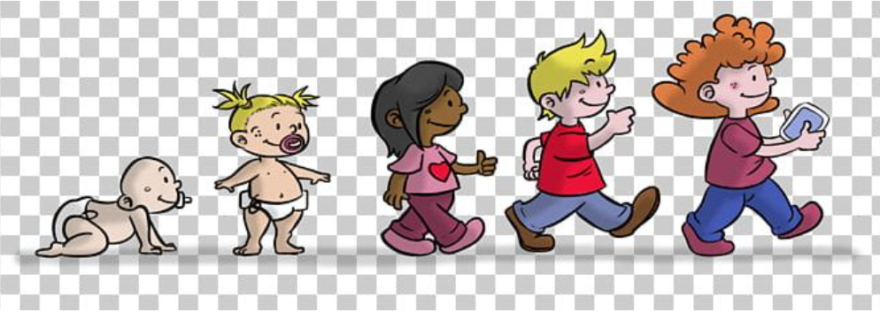
Lars learns to hunt, fish and swim.
What skills have you learnt since you were a baby?
Did your parents teach you anything?
Were you ever scared when you first tried?
Write a list of skills you have learnt over the years.
Eg. crawl,gurgle >walk, talk >jump, hop, ride a scooter > skip, ride a bike, read, write> swim, type etc.

Slide 7
Name What do you learn at each of these stages? 13/11/20
0-1 years | 1-2 years | 3 and 4 yrs | 5and 6 yrs | 7+years

