Slide 2
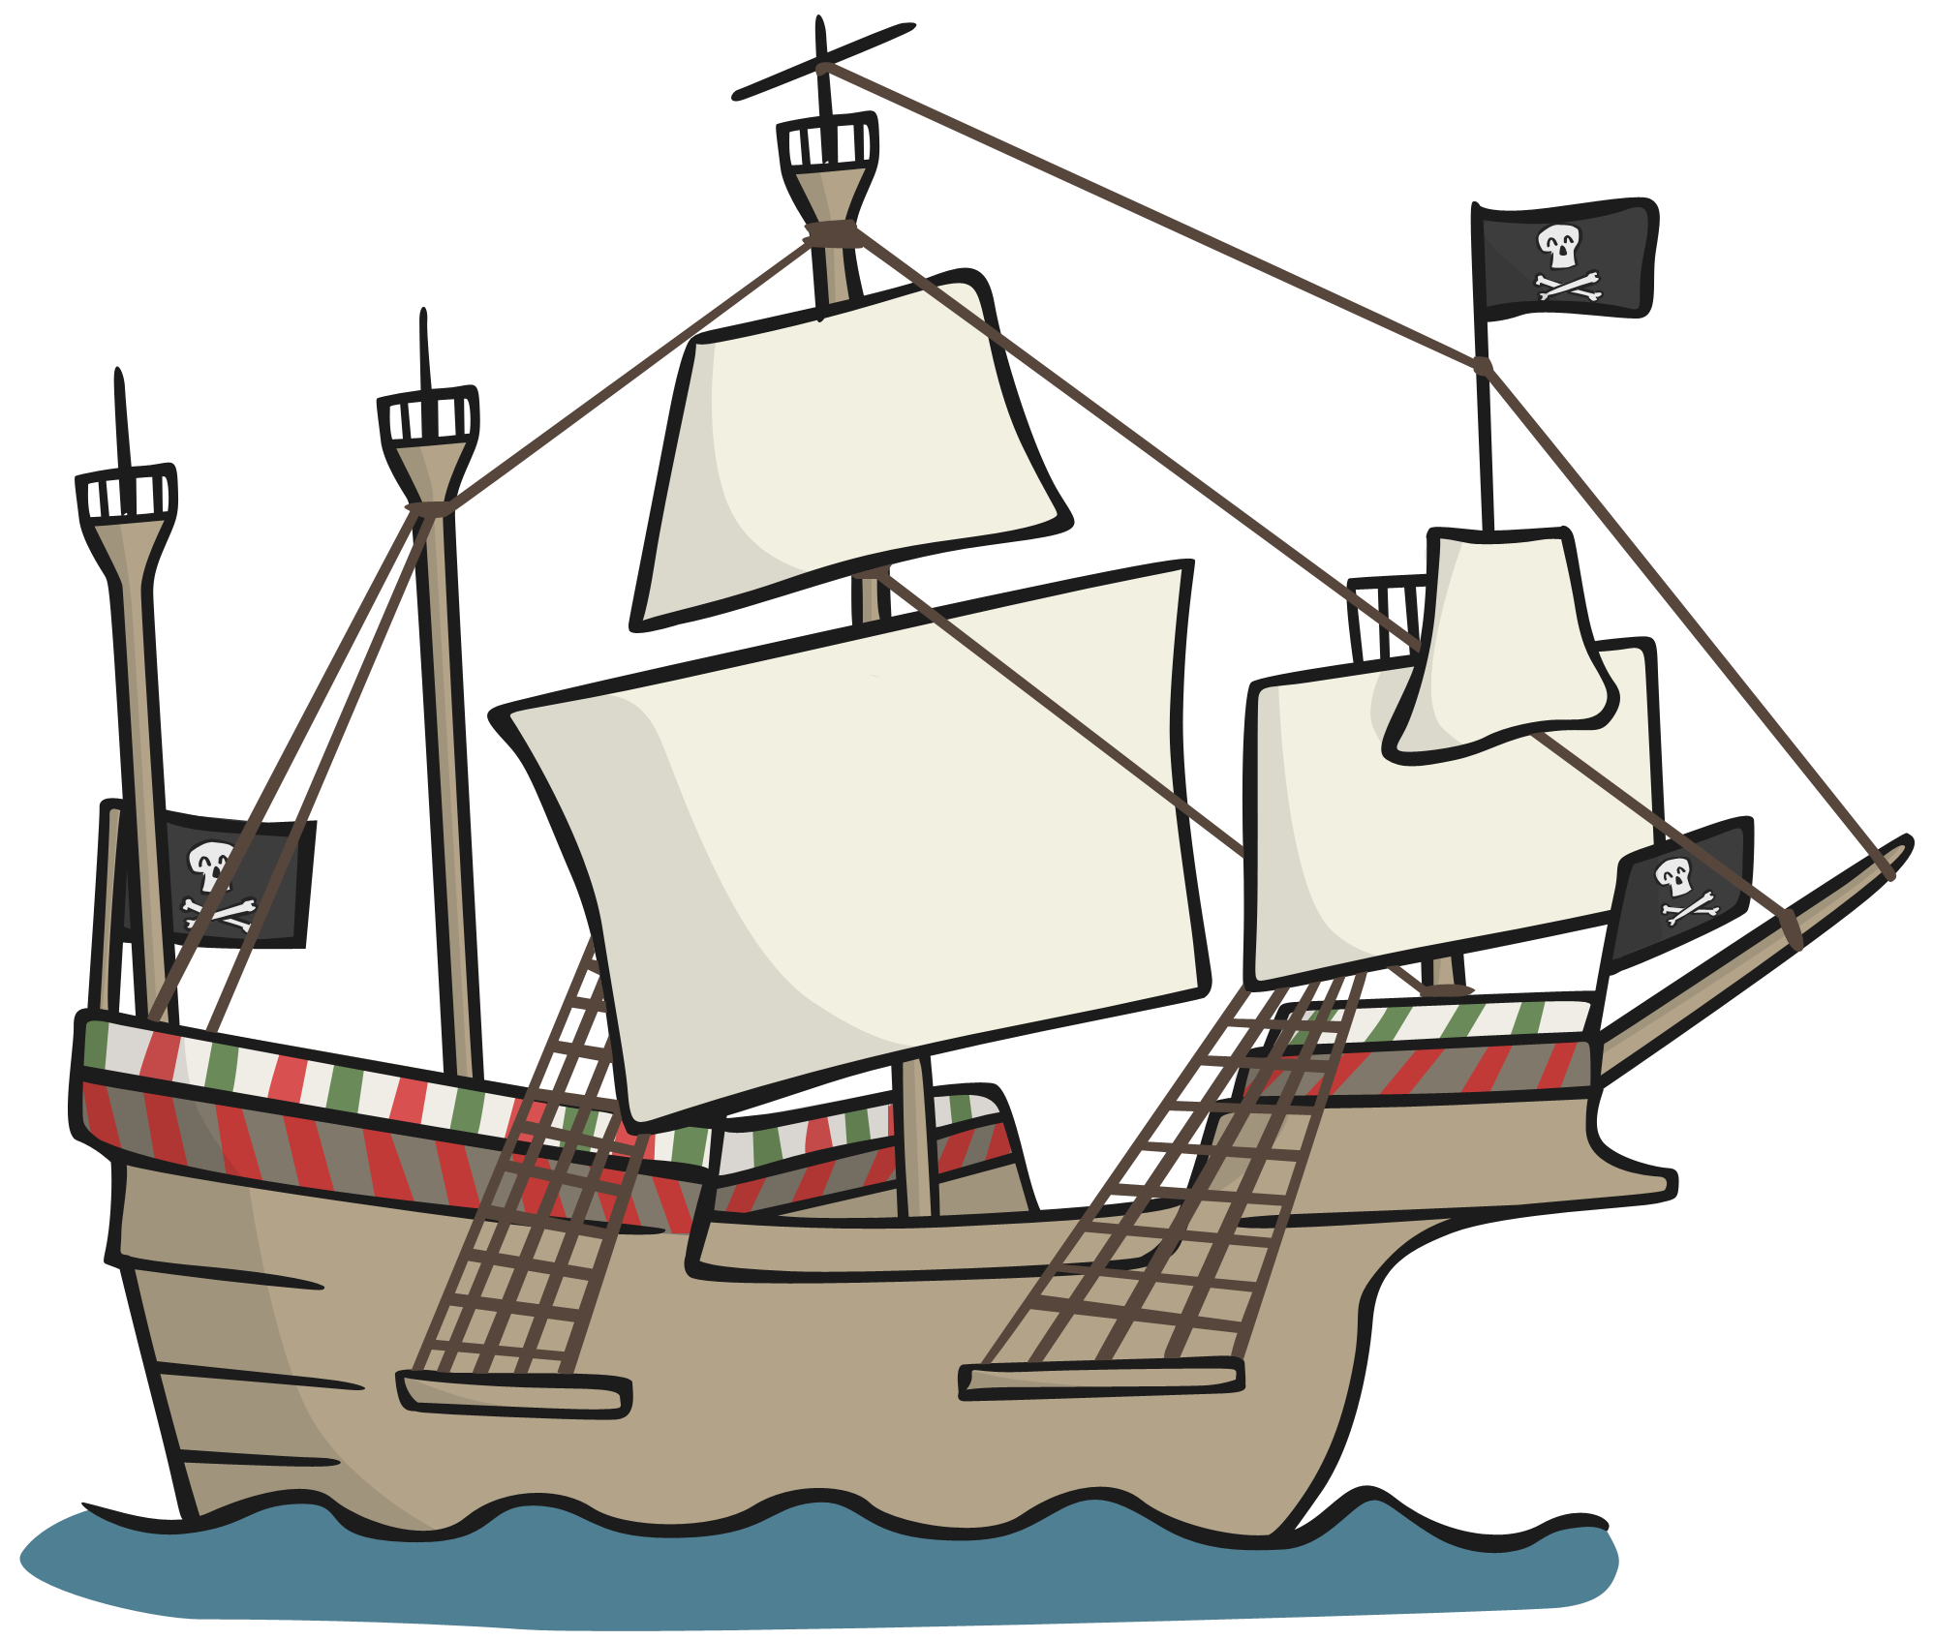
Parts of a Pirate Ship
Types of Pirate Ship
flag
sail
mast
stern
rigging
gun port
bow

Slide 3
Parts of a Pirate Ship
Types of Pirate Ship
flag
sail
mast
stern
rigging
gun port
bow

Slide 4
Sail
Parts of a Pirate Ship
Types of Pirate Ship
The sails of a ship were made from strong fabric and tied to the mast with thick ropes.
Each sail would collect the wind that blew into them and moved the ship forwards.
The sails could be tied away when they weren’t needed.

Slide 5
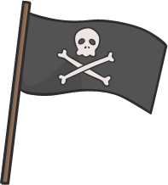
Flag
Parts of a Pirate Ship
Types of Pirate Ship
The pirate flag was traditionally a black flag with a white skull and crossbones. It showed other sailors that there were pirates on board.
It is known as the ‘Jolly Roger’.
Sometimes, pirates would fly a different flag to get close to other ships so they didn’t scare them away and then change it to the Jolly Roger when they were close enough to attack.

Slide 6
Mast
Parts of a Pirate Ship
Types of Pirate Ship
Masts were large wooden poles that stood up tall from the ship’s deck. They were used to attach the sails and rigging.
Some larger ships had platforms at the top of a mast called a ‘crow’s nest’ which pirates could use to look out over long distances.

Slide 7
Stern
Parts of a Pirate Ship
Types of Pirate Ship
The stern was the back of the ship. The rudder – a piece of wood to help steer the ship – was at the stern, dipping into the water.
The stern is where the captain’s cabin and the officer’s quarters would be.
Above the captain’s quarters would be the highest deck on the ship, known as the poop deck.

Slide 8
Gun Port
Parts of a Pirate Ship
Types of Pirate Ship
The gun ports (sometimes called ‘portholes’) were holes in the side of the ship which could be opened so the cannons could be fired at other ships.
Each gun port had a small door to cover it when not in use.
The gun ports were put into the sides of the ships above where the water reaches to prevent flooding, although in heavy seas there was a risk they could let in some water.

Slide 9
Rigging
Parts of a Pirate Ship
Types of Pirate Ship
The rigging was lots of ropes which tied the ship’s sails to the masts and also helped the mast stand up.
It also let the pirates control the direction of the sails and how tight they were.
Pirates also used the rigging like ladders to climb higher up into the ship to work with the sails and to reach the crow’s nest.

Slide 10
Bow
Parts of a Pirate Ship
Types of Pirate Ship
The bow (rhymes with ‘now’) was the front of the ship.
Many ships had a ‘bowsprit’ at the front, which was a pole that stuck out from the front of a ship to help with navigation.
Some ships also had ‘figureheads’, special wooden carvings on the front of the ship in shapes, such as mermaids or religious figures, which pirates believed would bring them good fortune.
The crews’ quarters were in the bow of the ship.

Slide 11
Types of Pirate Ship
End
There were different types of ships used by pirates and each were useful in different ways. Some of these ships included:
Sloop
Schooner
Brigantine
Square-Rigger

Slide 12
Sloop
Types of Pirate Ship
End
This type of ship moved very quickly and easily and could sail in shallow water. It was perfect for chasing another ship to steal from!
It had one mast and could hold around 75 pirates and 10 cannons.

Slide 13
Schooner
Types of Pirate Ship
End
The schooner was slightly bigger than the sloop but was still fast and able to sail in shallow water.
It had two masts and had room for around 80 sailors and 10 cannons.
The schooner was one of the most popular ships for pirates to use because of their speed.

Slide 14
Brigantine
Types of Pirate Ship
End
The brigantine was larger than the sloop and schooner and had two masts with lots of sails.
It was faster than a sloop or schooner so became very popular with pirates.
It could hold around 125 pirates and 20 cannons!

Slide 15
Square-Rigger
Types of Pirate Ship
End
This huge and heavy ship was the ultimate type for showing off in and scaring enemies.
It carried lots of loot, up to 20 cannons and 200 men!
It also had an extra large cargo hold (for more loot!)
Photo courtesy of dmertl(@flickr.com) - granted under creative commons licence - attribution

