Slide 1
RE
Gifts and Giving
Year One
RE | Year 1 | Gifts and Giving | How Is Christmas Celebrated? | Lesson 2

Slide 3
Aim
I can explain how Christmas might be celebrated.
Success Criteria
I can tell you two ways Christmas might be celebrated.
I can explain why celebrating Christmas is important to many Christians.

Slide 4
How Is Christmas Celebrated?
In your groups, draw/write as many different ways of celebrating Christmas as you can think of.

Slide 5
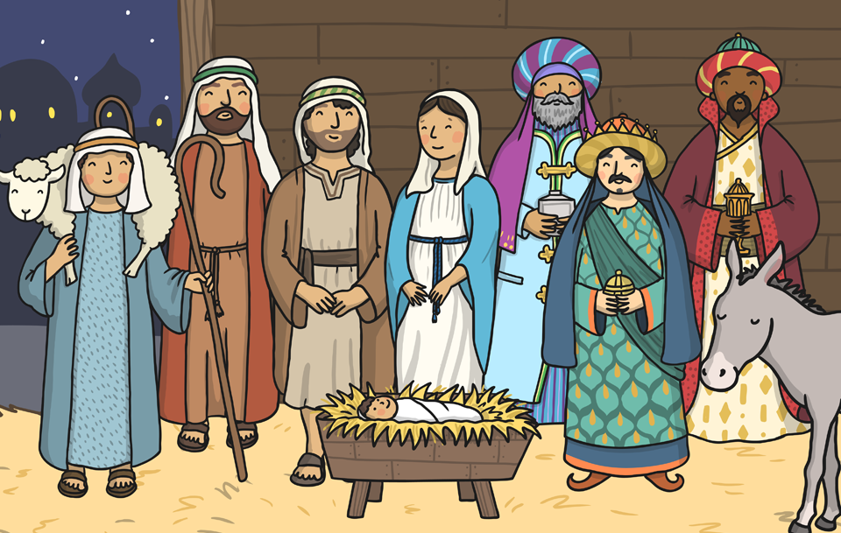
Why Is Celebrating Christmas Important to Many Christians?
Christmas is the time when many Christians remember and celebrate the birth of Jesus, the Son of God.
The story of the birth of Jesus is very important to many Christians and celebrating Christmas is one way Christians can remember Jesus.

Slide 6
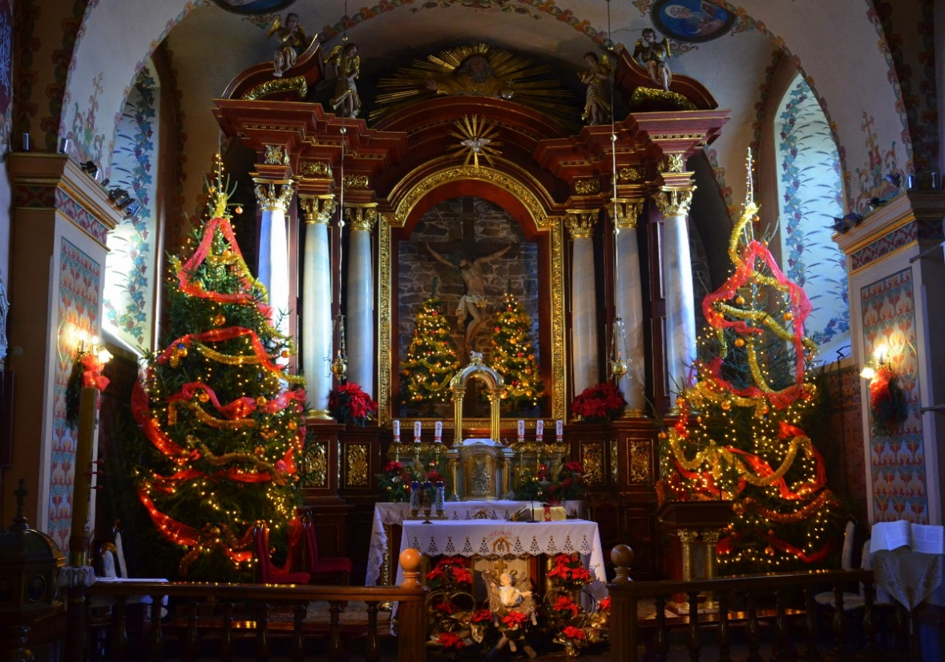
Christmas Traditions
Many Christians go to church to celebrate the birth of Jesus. Parts of the Bible are read and hymns and carols are sung. There are lots of special services around Christmas such as Christingle services, the Nativity service and carol services.
Photo courtesy of Silar (@wikipedia.org) - granted under creative commons licence – attribution

Slide 7
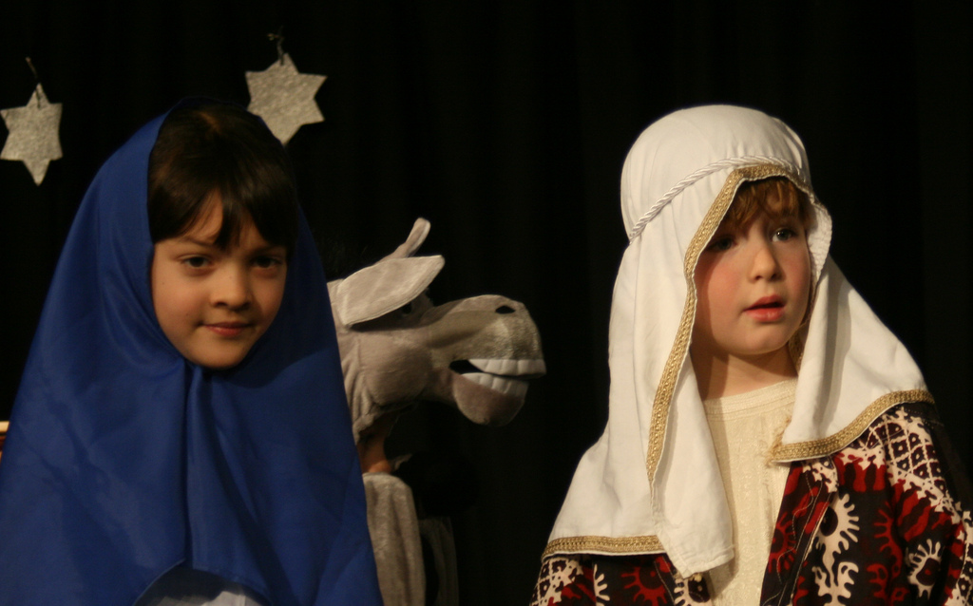
Christmas Traditions
Lots of churches and schools act out the Nativity story to remind Christians why Christmas is celebrated.
Photo courtesy of cowley_mail (@flickr.com) - granted under creative commons licence – attribution

Slide 8
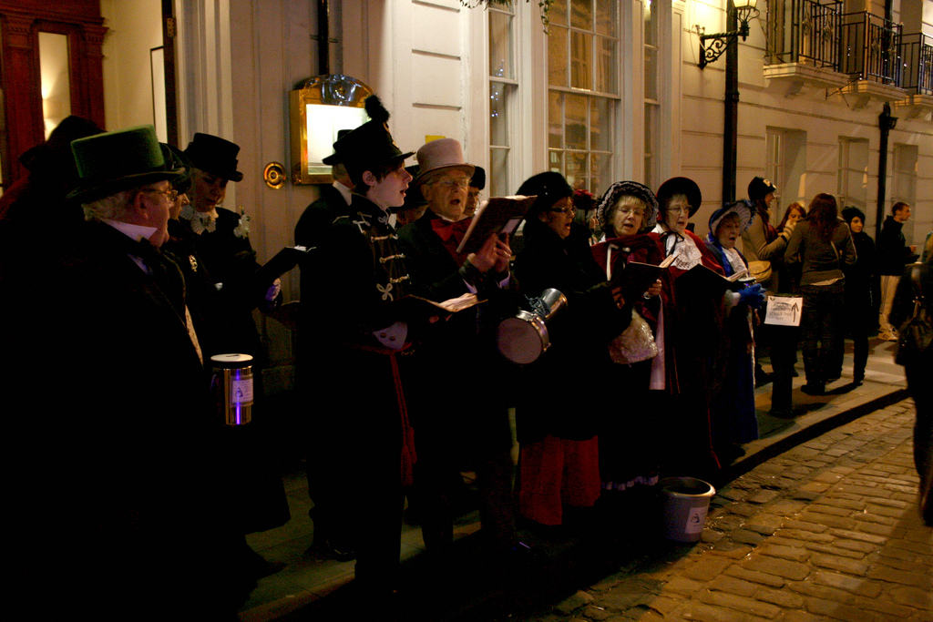
Christmas Traditions
Carols are often sung in churches and schools. Some people go carol singing to raise money for charity.
Photo courtesy of jig o’dance (@flickr.com) - granted under creative commons licence – attribution

Slide 9
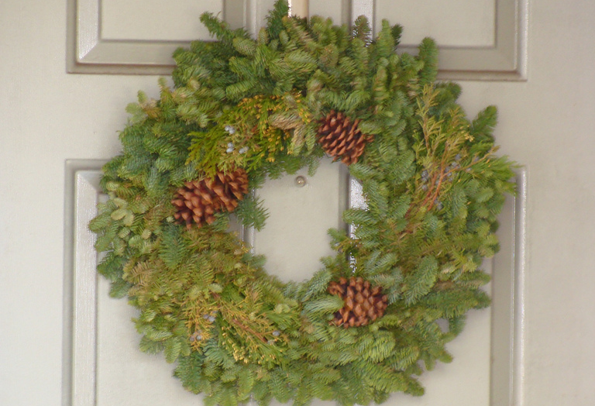
Christmas Traditions
Some people hang wreaths made from evergreens on their doors. The evergreens remind many Christians of the everlasting life of Jesus.
Photo courtesy of Pseudodude (@flickr.com) - granted under creative commons licence – attribution

Slide 10
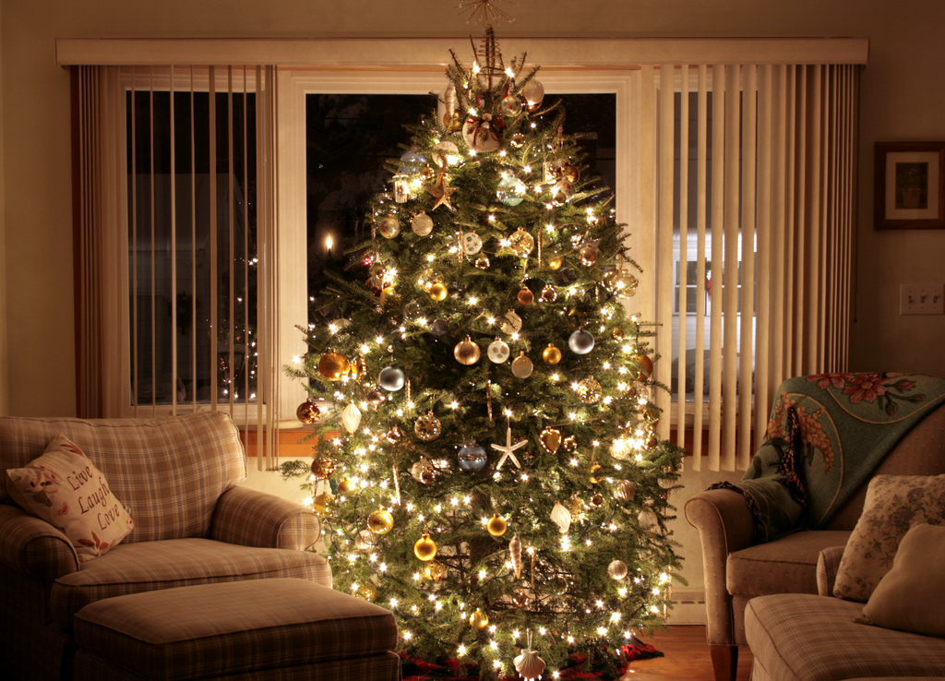
Christmas Traditions
Many people put Christmas trees up in their houses and decorate them with fairy lights, tinsel and decorations.
Photo courtesy of timomcd (@flickr.com) - granted under creative commons licence – attribution

Slide 11
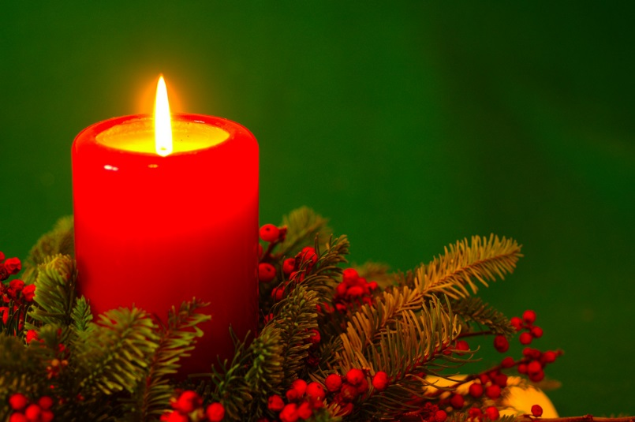
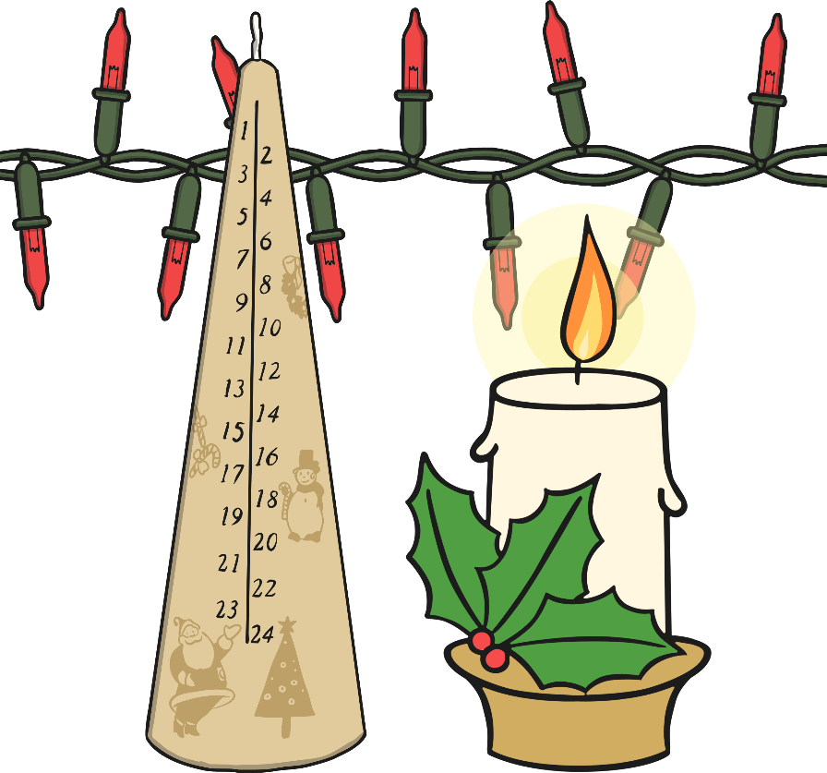
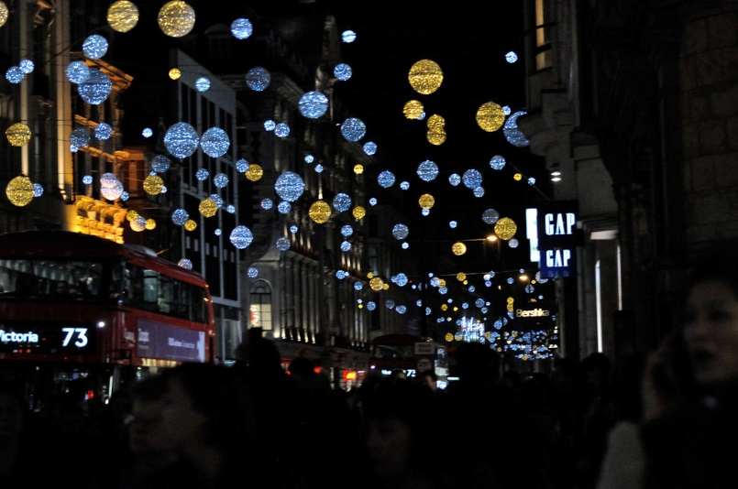
Christmas Traditions
Candles and lights can represent the Star of Bethlehem and Jesus, as he is often called ‘The Light of the World’.
Photo courtesy of m.shattock (@flickr.com) - granted under creative commons licence – attribution

Slide 12
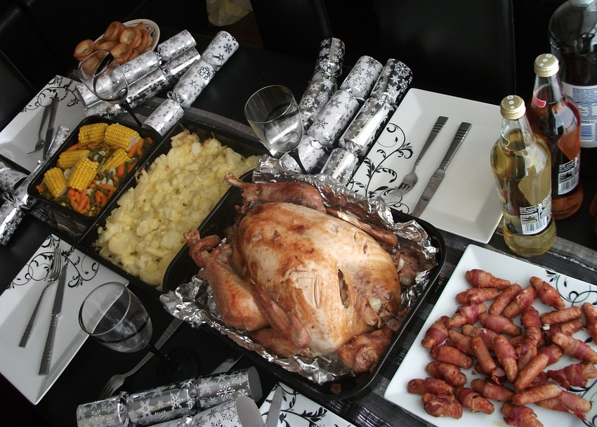
Christmas Traditions
Many families get together and eat a special roast dinner.

Slide 13
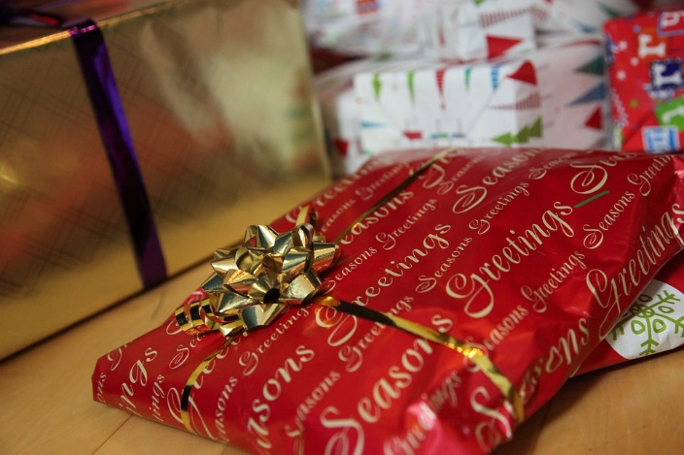
Christmas Traditions
People can give each other presents which are wrapped in Christmas wrapping paper and are usually opened on Christmas Day.

Slide 14
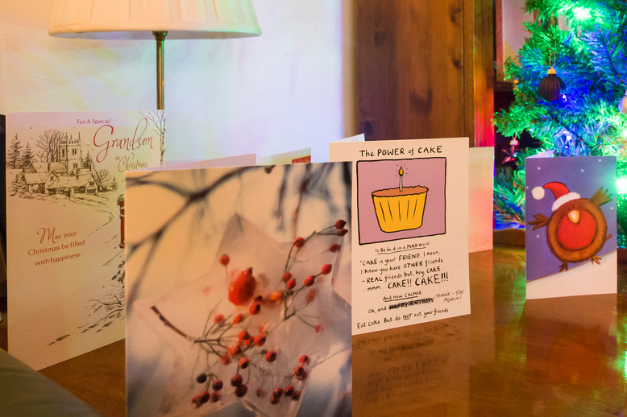
Christmas Traditions
People can exchange Christmas cards which are then put up in homes.
Photo courtesy of James E. Petts (@flickr.com) - granted under creative commons licence – attribution

Slide 15
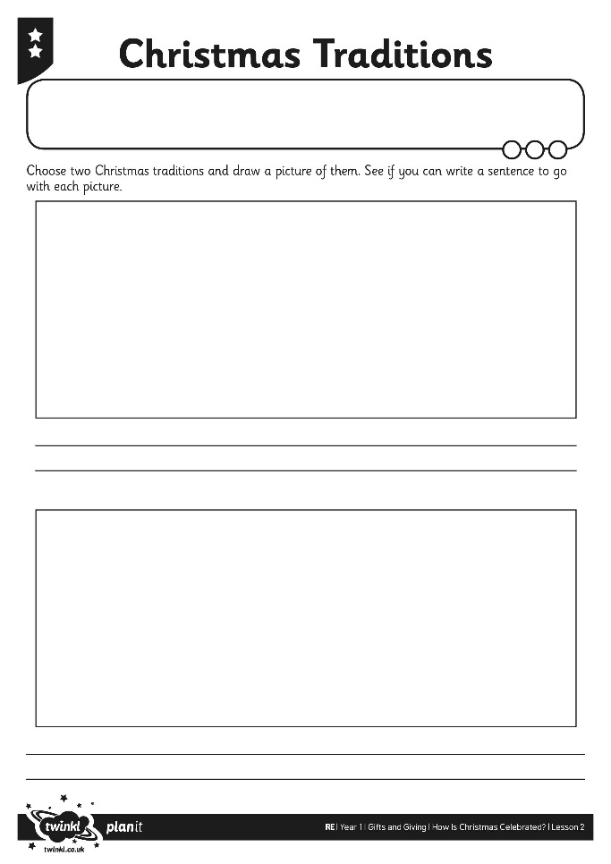
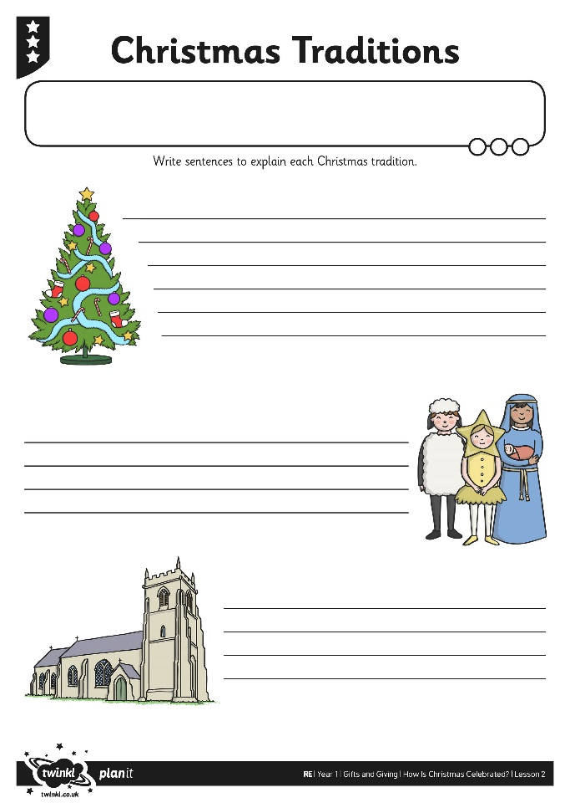
Christmas Traditions
Activity

Slide 16
Christmas Riddles
I have a Christmas picture on my front.
People write inside me.
I get put in an envelope.
I sometimes get put in the postbox.
What am I?
A Christmas card

Slide 17
Christmas Riddles
I am tall.
I can live inside or outside.
I have lot of lights on me.
I am usually green.
What am I?
A Christmas tree

Slide 18
Christmas Riddles
I can come in all shapes and sizes.
I get wrapped up in pretty paper.
I get given to someone.
Then I get unwrapped.
What am I?
A Christmas
present

Slide 19
Aim
I can explain how Christmas might be celebrated.
Success Criteria
I can tell you two ways Christmas might be celebrated.
I can explain why celebrating Christmas is important to many Christians.

