Slide 1
RE
Gifts and Giving
Year One
RE | Year 1 | Gifts and Giving | What Is Christmas? | Lesson 1

Slide 3
Aim
I can explain what Christmas is.
Success Criteria
I can explain when and why Christmas is celebrated.
I can sequence the Christmas Story.

Slide 4
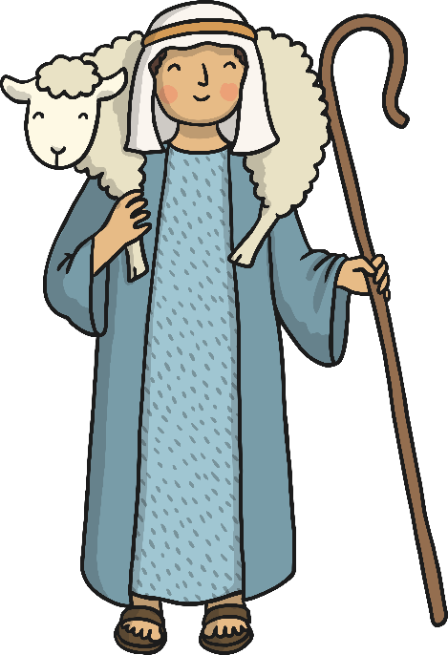
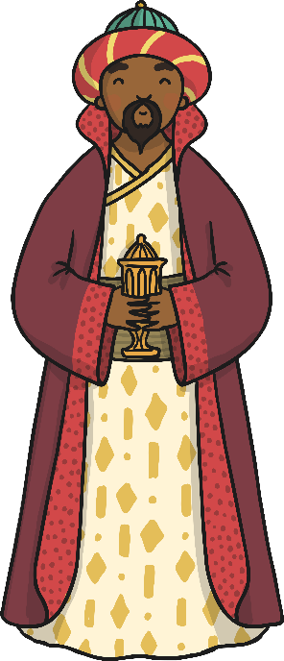
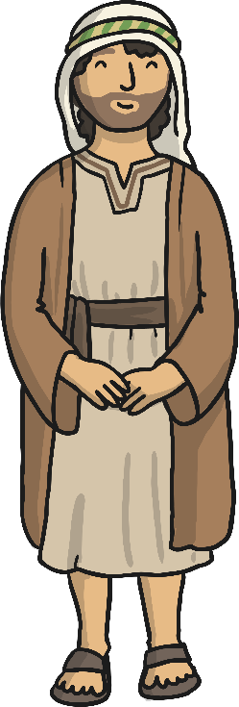
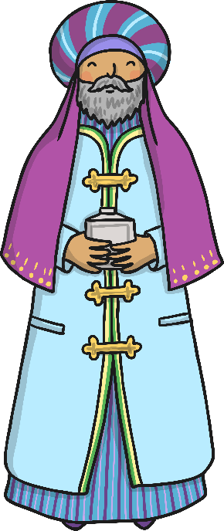
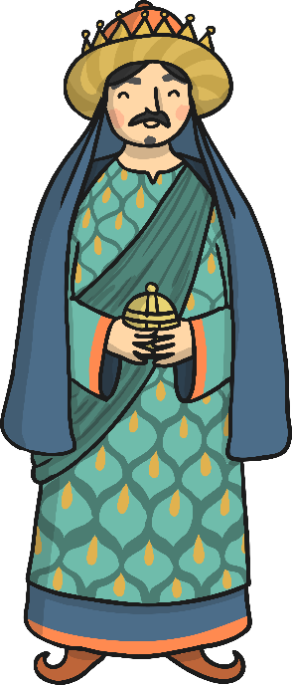
What Is Christmas?
When you think about Christmas, what do you think of?
Christmas is the time when many Christians remember and celebrate the birth of Jesus, the son of God.

Slide 5
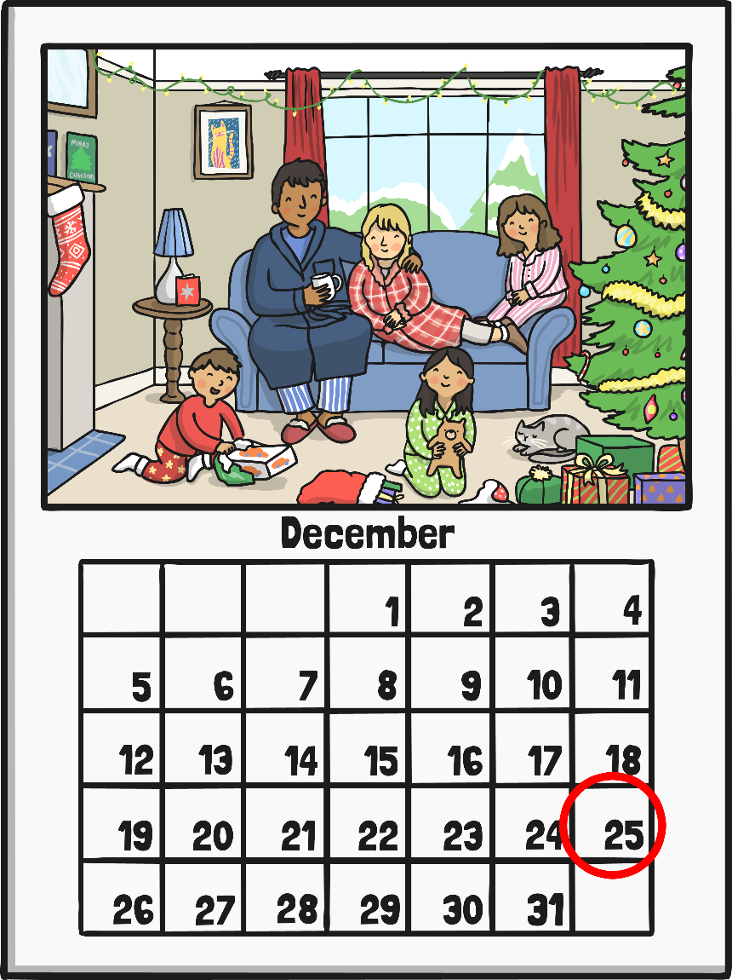
When Is Christmas?
Christmas Day is celebrated by many Christians all over the world on 25th December every year. It is a special holiday when most offices, shops and all schools are closed.

Slide 6
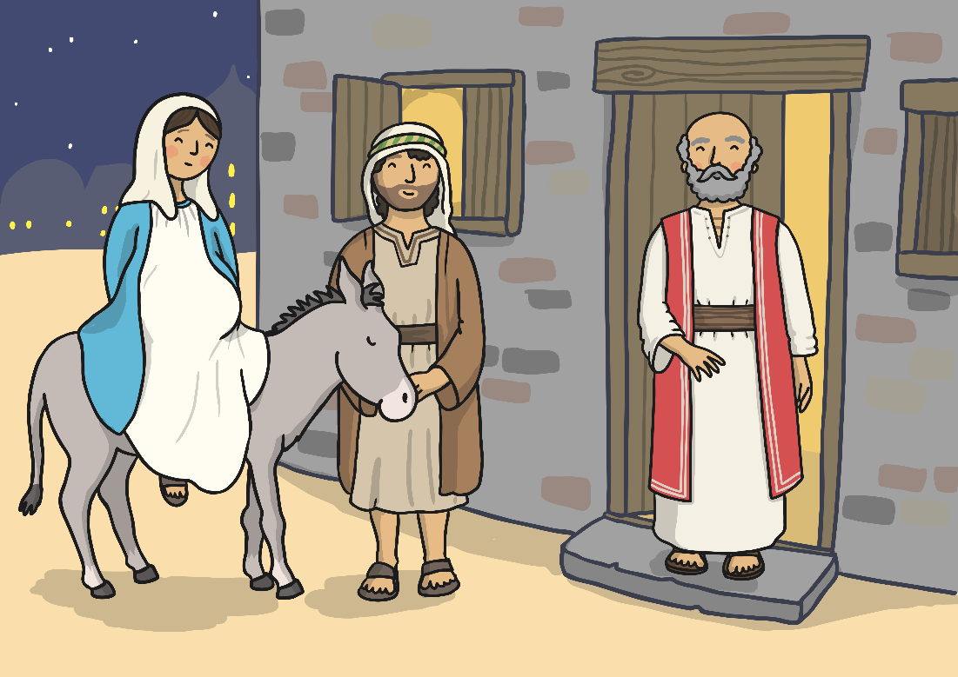
The Birth of Jesus
The story of the birth of Jesus is very important to many Christians.
At Christmas, lots of schools and churches perform a nativity, which is a play that tells of the story of the birth of Jesus.
The first nativity was performed in Italy in around 1223. It was shown to people who couldn’t read the story for themselves.

Slide 7
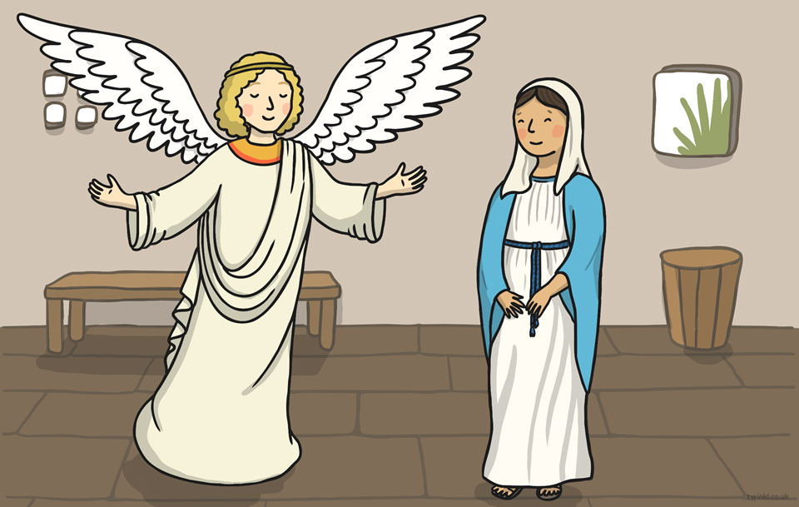
The Christmas Story
The Angel Gabriel visited Mary and told her she was going to have a baby called Jesus. The baby would be God’s son.

Slide 8
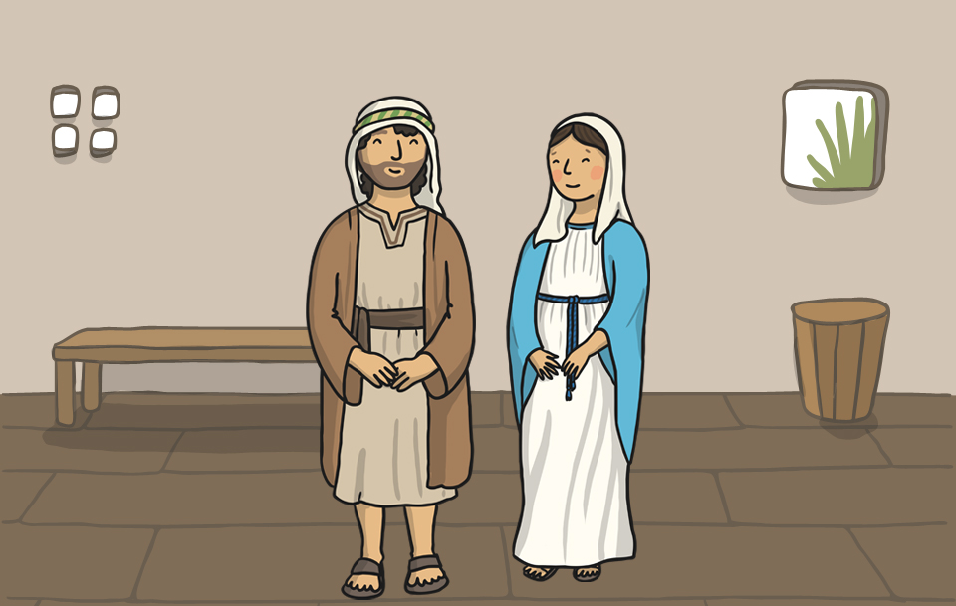
The Christmas Story
Mary told Joseph what Gabriel had told her; they prepared for the arrival of the special baby.

Slide 9
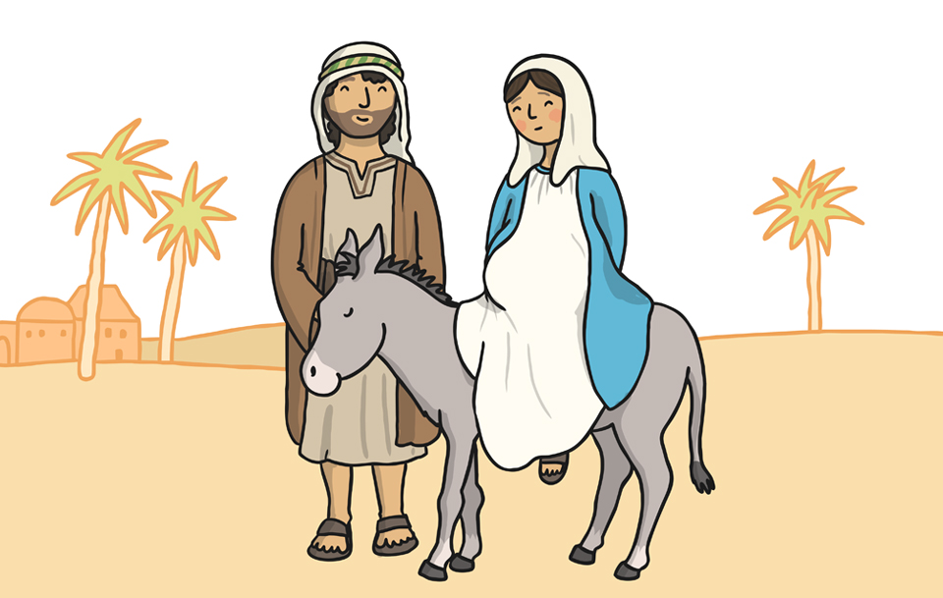
The Christmas Story
Mary and Joseph had to travel to Bethlehem to pay taxes. Mary rode on a donkey.

Slide 10
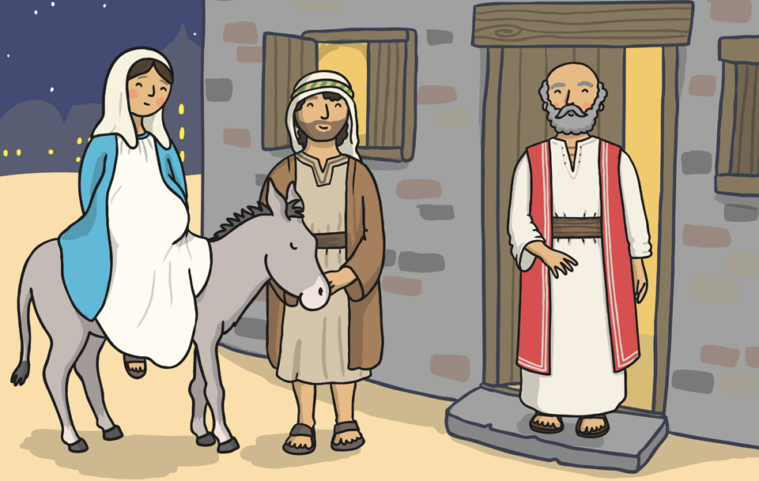
The Christmas Story
A kind innkeeper in Bethlehem let Mary and Joseph stay in his stable for the night.

Slide 11
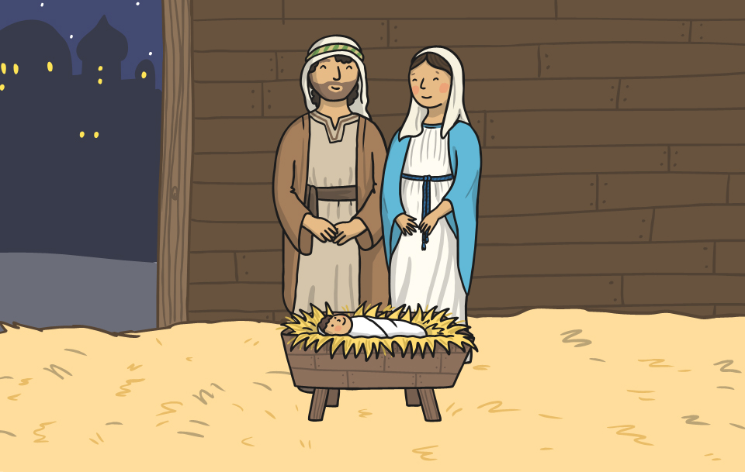
The Christmas Story
Baby Jesus was born in the stable.

Slide 12
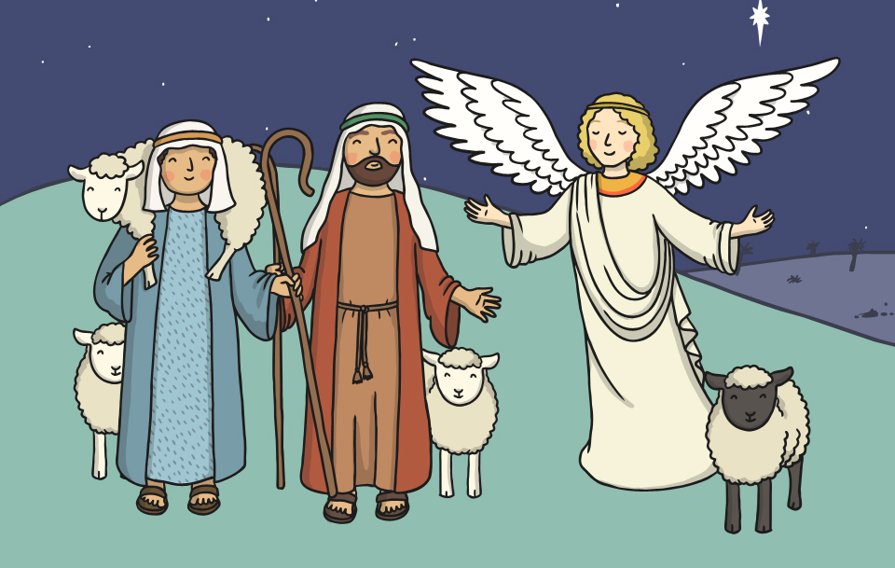
The Christmas Story
At the same time, an angel appeared to some shepherds. The angel told them that the son of God had been born in Bethlehem.

Slide 13
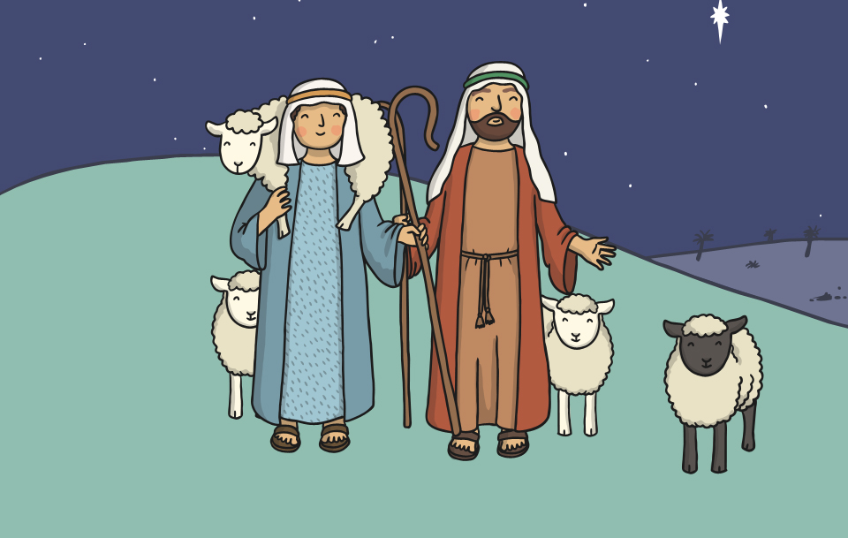
The Christmas Story
The shepherds walked to Bethlehem to visit the baby Jesus.

Slide 14
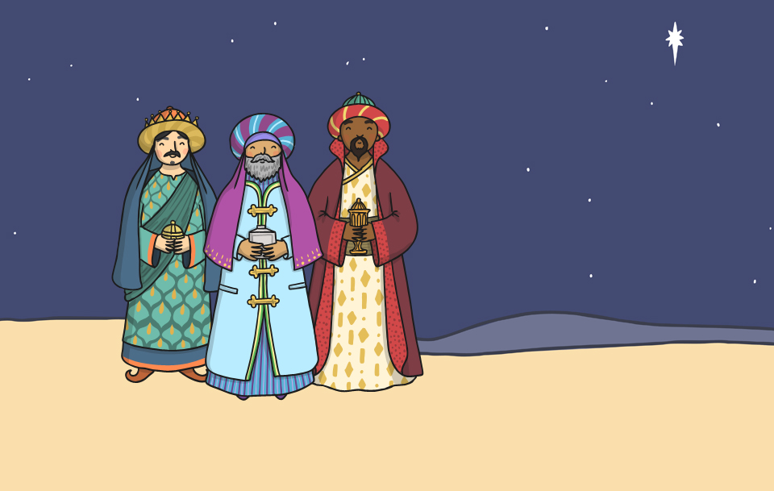
The Christmas Story
Far away in the East, three wise men saw a bright star in the sky. They knew it meant that a new king had been born and followed the star.

Slide 15
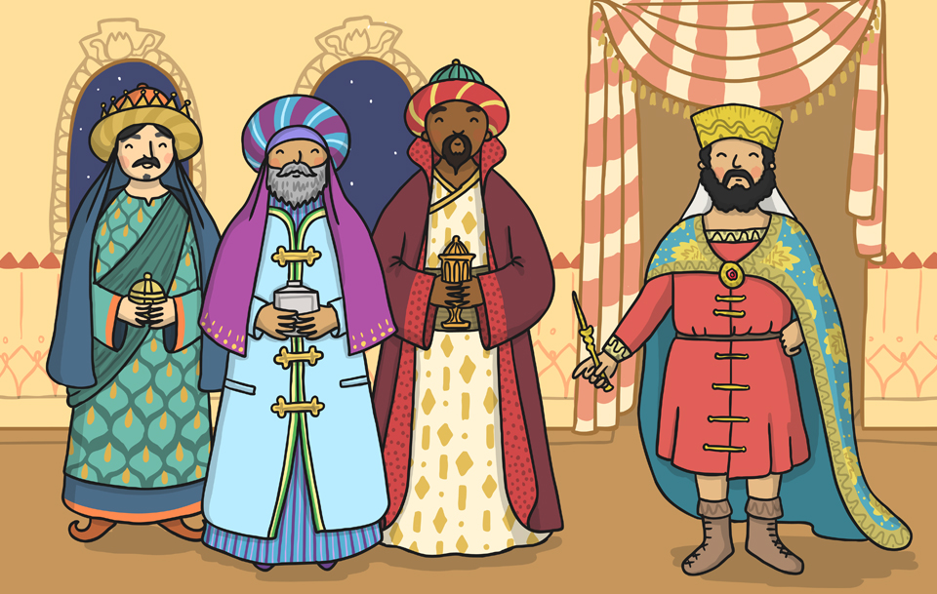
The Christmas Story
On the way, they came to King Herod’s palace. Herod was curious about the new king; he asked the wise men to tell him where the baby was.

Slide 16
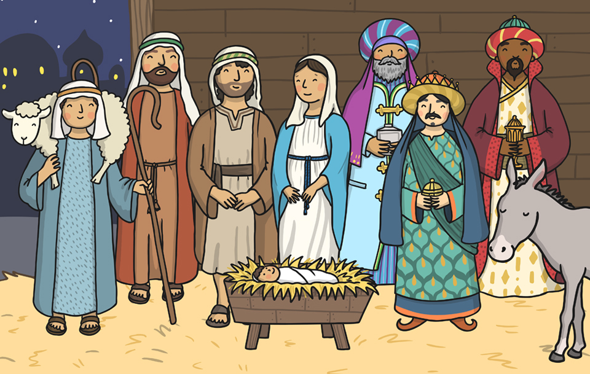
The Christmas Story
The wise men reached Bethlehem. They gave Jesus gifts of gold, frankincense and myrrh.

Slide 17
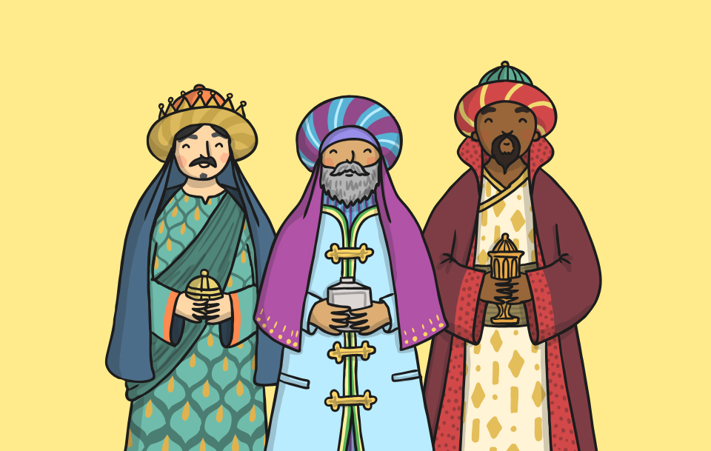
The Christmas Story
That night, the wise men had a dream warning them not to tell King Herod where Jesus was. They did not return to King Herod’s palace.

Slide 18
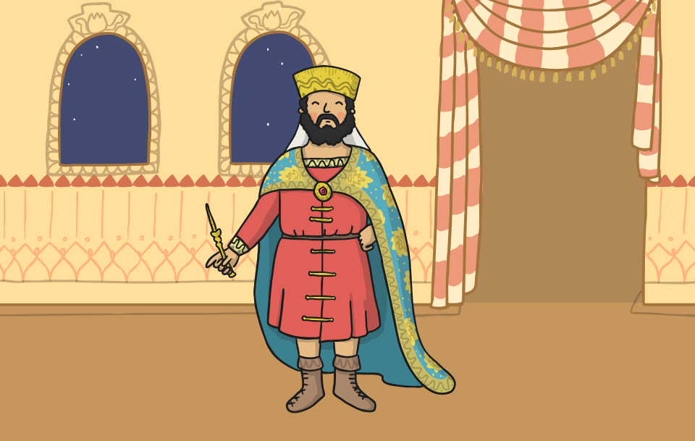
The Christmas Story
Herod began to search for Baby Jesus. He ordered that all baby boys in Bethlehem be killed.

Slide 19
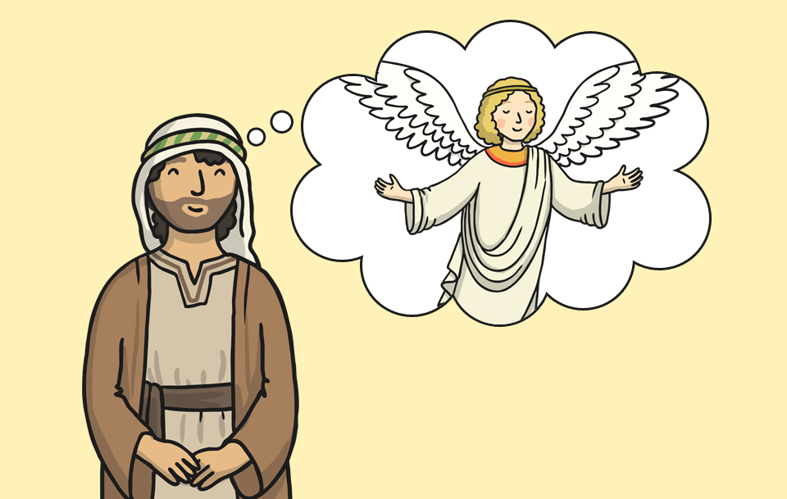
The Christmas Story
Joseph had a dream where an angel told him to take Mary and Jesus to Egypt.

Slide 20
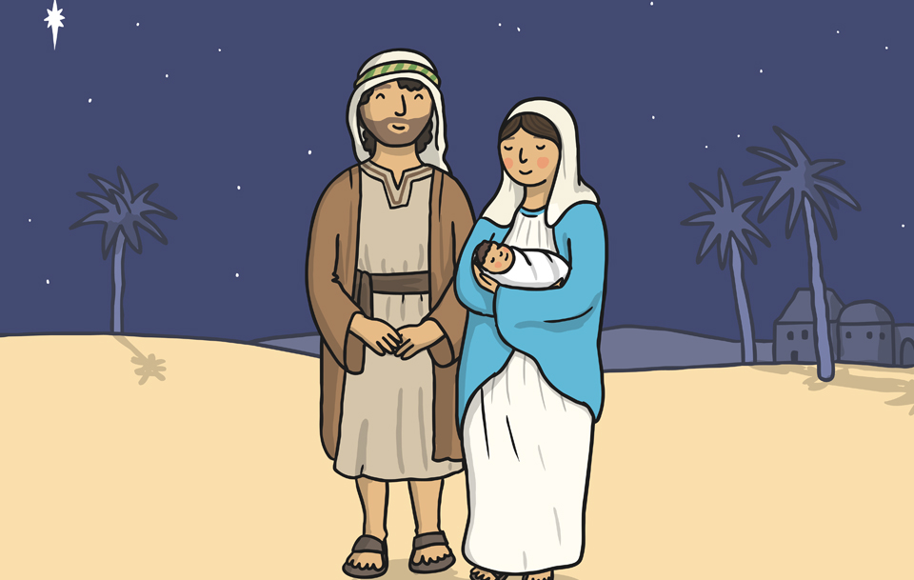
The Christmas Story
Mary and Joseph travelled to Egypt with Baby Jesus and he was safe.

Slide 21
Christmas Story Activities

Slide 22
Freeze Frames
Choose one of the Freeze Frame Cards. See if you can make your own freeze frame to show this part of the story.

Slide 23
Aim
I can explain what Christmas is.
Success Criteria
I can explain when and why Christmas is celebrated.
I can sequence the Christmas Story.

